Slide 1
Appendix A

Slide 2
Tutorial
Isotope Profile Deconvoluted Chromatogram (IPDC) algorithm for high resolution mass spectrometry non-targeted screening using MATLAB scripts
Sadjad Fakouri Baygi
March 2019

Slide 3
An instruction to the IPDC algorithm
The IPDC algorithm is designed to process high-resolution mass spectrometry files in MATLAB environment to detect isotopic patterns.
This document will be published along with a paper titled “Automated Isotopic Profile Deconvolution for High Resolution Mass Spectrometric data (APGC-QToF) from Biological Matrices” in the pubs.acs.org portal.

Slide 4
Converting continuum mass spectra into centroid format using MassLynx
Notes:
Note: If your data file are already in centroid mode, move to slide 5.

Slide 5
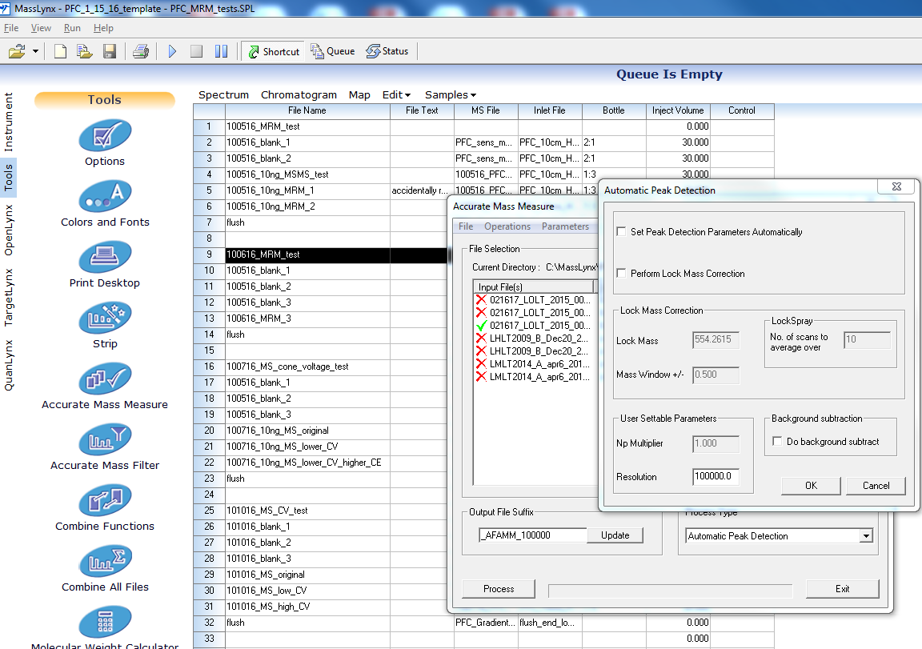
Continuum mass spectra → Centroid
Notes:
The resolution might change based on your data quality, but resolution of 100,000 worked the best so far for APGC data

Slide 6
mzXML conversion using MATLAB and massWolf

Slide 7
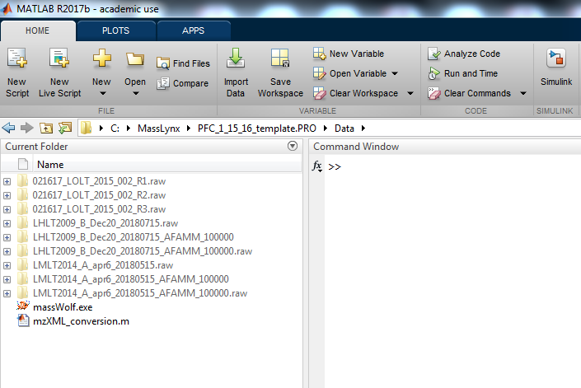
The directory of MATLAB should be where the .RAW data are present

Slide 8
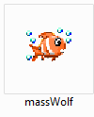
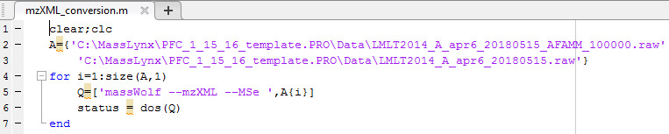
.RAW → .mzXML conversion
The massWolf 4.3.1 executable file should be in the same folder with the “RAW” data file(s).
Modify the address(es) of .RAW file(s) in mzXML_conversion.m and run it.
Address of .RAW file(s)
Notes:
To download massWolf: https://sourceforge.net/p/sashimi/discussion/235607
Address of .RAW files must be inside single quotations.
To run multiple files, put the second address in the next line inside single quotations
Runtime: 5 minutes - 2 hours on average for each file
In order to use massWolf, MassLynx should be installed on your system.

Slide 9
IDPC algorithm in MATLAB
Click here to download the MATLAB scripts

Slide 10
MATLAB requirement
MATLAB 2017b
Bioinformatics toolbox
Parallel computing toolbox
Signal processing toolbox
Deep learning toolbox (To train false positive removal modules)
Optimization toolbox (To find coefficients in the score function)

Slide 11
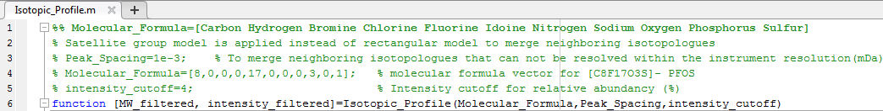
How to calculate isotopic profiles?
The Isotopic_Profile function can also be used as a standalone function to calculate isotopic profiles.

Slide 12
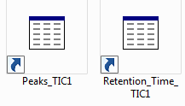
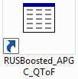
Example
The low energy channel of a PCB reference standard is presented in the MATLAB format in the Supporting information.
The optimized “RUSBoosted_APGC_QToF” is presented as well.

Slide 13
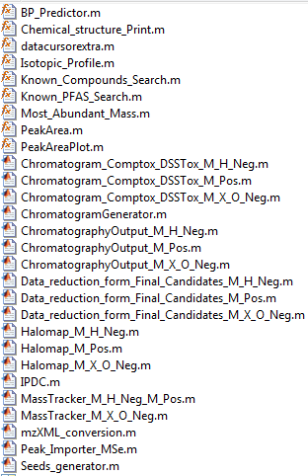
To initiate the screening, all these files should be in a same folder along with the mzXML file and they should be executed in the following order:
Seeds_generator.m
Peak_Importer_MSe.m
IPDC.m
The chromatography calculation:
ChromatographyOutput_M_H_Neg.m for [M-H]⁻ ionization
ChromatographyOutput_M_Pos.m for [M]⁺ ionization
ChromatographyOutput_M_X_O_Neg.m for [M-X+O]⁻ and [M]⁻ ionizations

Slide 14
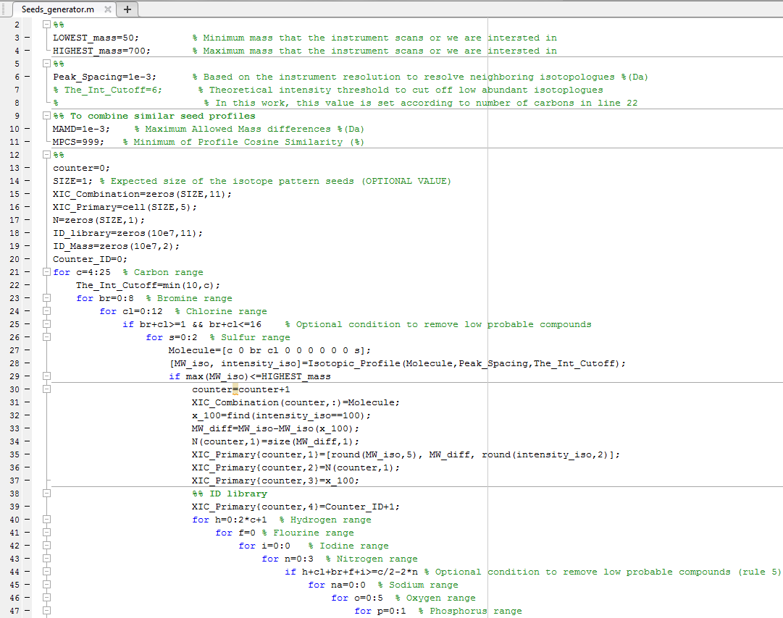
1) Seeds generator
Change elemental composition ranges
Notes:
The number of atoms of each element must be in the following order:
%% Molecule=[Carbon Hydrogen Bromine Chlorine Fluorine Iodine Nitrogen Sodium Oxygen Phosphorus Sulfur]
Runtime < 1 minute

Slide 15
Output of Seeds_generator
XIC_Combination.mat is a matrix of C/Br/Cl/S combinations
XIC_Primary.mat contains the original profile seeds
C |  | Br | Cl |  |  |  |  |  |  | S
Isotopic profile seed: Column 1: Masses of seed Column2: Mass differences Column 3: Intensity ratios | Number of isotopologues | Index of the most abundant isotopologue | ID of the first compound associated with this isotopic seed profile | ID of the last compound associated with this isotopic seed profile
Notes:
Number of rows in XIC_Combination and XIC_Primary variables are the same and indicate the number of C/Br/Cl/S combinations.
Number of rows in ID_library variable indicate the total number of targeted compounds.

Slide 16
Output of Seeds_generator
ID_library.mat is a matrix of elemental composition and each row number indicates the ID of the compound
ID_Mass.mat is a matrix of mass of elemental composition for each ID
XIC_Quick.mat contains the combined profile seeds
C | H | Br | Cl | F | I | N | Na | O | P | S
Mass of the most abundant isotopologue of the ID compound | Mass of the H/F/I/N/Na/O/P of the ID compound
Notes:
Number of rows in XIC_Combination and XIC_Primary variables are the same and indicate the number of C/Br/Cl/S combinations.
Number of rows in ID_library variable indicate the total number of targeted compounds.

Slide 17
.mzXML → .mat conversion
2) Peak_Importer_MSe
“.mat” is the MATLAB data extension and all files must be in this MATLAB readable format
Fill line 3 in the .mzXML file
Notes:
This file is designed to convert MS^{e} .mzXML data into .mat files but also is compatible with single channel data.
Runtime : 5-60 minutes

Slide 18
Output of Peak_Importer_MSe
Peaks_TIC1.mat contains m/z peaks in channel 1
Retention_Time_TIC1.mat contains retention times of channel 1 and is corresponded to Peaks_TIC1.mat
basePeaks.mat contains the basepeak in each chromatogram scan
Peaks_TIC2.mat contains m/z peaks in channel 2
Retention_Time_TIC2.mat contains retention times of channel 2 and is corresponded to Peaks_TIC2.mat

Slide 19
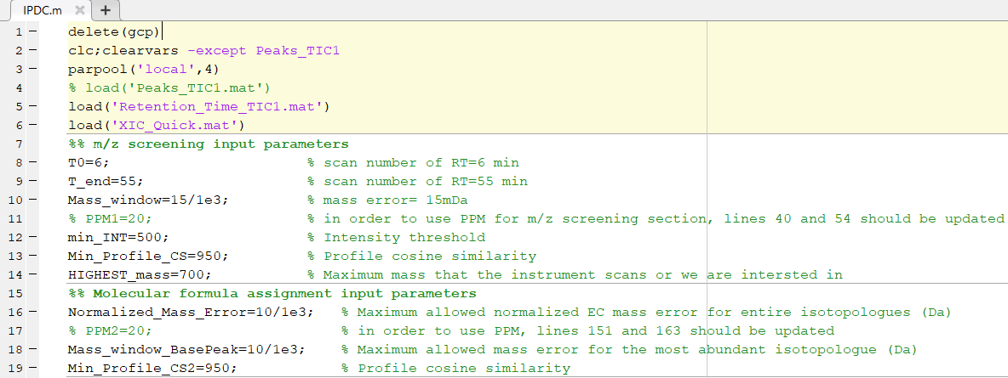
3) IPDC.m
Notes:
If Peaks_TIC1.mat is not available in Workspace, percentage symbols (%) should be removed in order to execute line 4
Runtime: 1-24 hours on average

Slide 20
Optional output of IPDC.m
Primary_Match.mat contains detected halogenated species. Saving this file is optional (line 118 should be updated) and often takes more than 1 hour.
As long as you don’t change the C/Br/Cl/S combinations in seeds_generator, Primary_Match.mat file is valid for other processes.

Slide 21
Output of IPDC.m
Final_Matches.mat is a matrix that its each row has the following parameters
ID in MATLAB code | Experimental Mass (Da) | Exact Mass (Da) | Intensity | NEME (mDa) | PCS (‰) | Scan Number

Slide 22

Chromatographic behavior analysis
Chromatographic analysis is an essential part of the IPDC algorithm and mostly the ‘Peak_Area’ MATLAB function is used to perform this step.
‘Peak_Area’ function is incorporated in the following scripts, but could be used to develop more modules for different ionization pathways.
ChromatographyOutput_M_Pos.m for [M]⁺ ionization
ChromatographyOutput_M_H_Neg.m for [M-H]⁻ ionization
ChromatographyOutput_M_X_O_Neg.m for [M-Cl+O]- ionization

Slide 23
Inputs of ‘Peak_Area’ module
Peaks_TIC1 form the Peak_Importer module
Retention_Time_TIC1 form the Peak_Importer module
IsotopeModel: A matrix containing a theoretical isotopic profile for a compound in two columns ([Mass (Da), intensity(%)])
Mass_error: The mass error used in the IPDC algorithm
Int: A vector of intensities of detected compounds in different scan numbers from column 4 in Final_Matches.mat
Scan_Number: A vector of intensities of detected compounds in different scan numbers from column 7 in Final_Matches.mat
Chromatogram_scan_interval: Maximum space between two matched chromatogram scans to fill missing chromatogram scans within a given peak
Smoothing_window: a value used to smooth each given chromatographic peak
noise_removal: To remove low abundant non-isobaric features that are below (%) of the most abundant isobaric feature. To have a clear baseline and removing noises
Max_No_isomers: To focus on high abundant non-isobaric features.
min_INT: The intensity threshold used in the IPDC algorithm

Slide 24
Outputs of ‘Peak_Area’ module
No_Isomer: Number of non-isobaric features for a molecular formula
ScanNumber_isomers: Chromatographic scan numbers that contain full isotopic profiles of all non-isobaric features of a molecular formula
PA_isomers: Peak area of non-isobaric features
w_Int: Peak width at intensity threshold for each non-isobaric features
RPW: Ratio of peak width to half-height to baseline
neme: Average normalized Euclidean mass error across chromatographic peaks for non-isobaric features
pcs: Average profile cosine similarity across chromatographic peaks for non-isobaric features

Slide 25
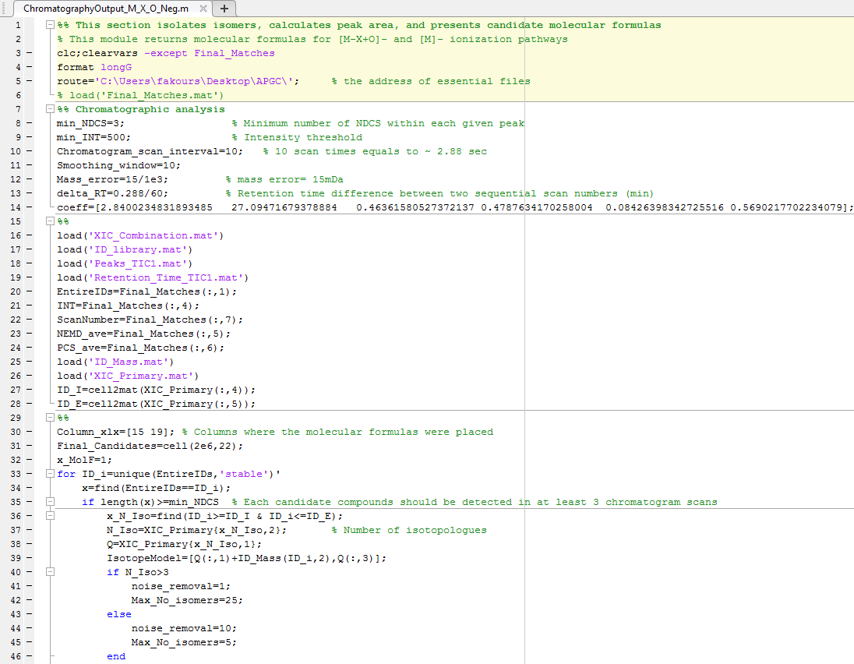
4) ChromatographyOutput_M_X_O_Neg
Notes:
This file should be determined according to the ionization pathway. “noise_removal” and “Max_No_isomers” parameters in lines 39-44 are chosen based on the Number of isotopologues here, but fixed values could be used for them as well.
Runtime: 1-24 hours on average

Slide 26
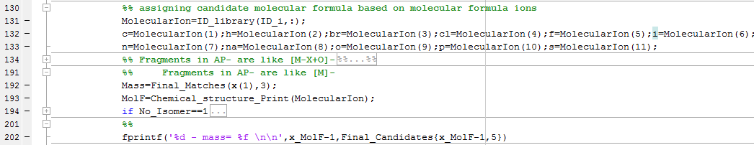
Lines 130-201 are designed to return the potential compounds according to dominant ionization pathways
Notes:
This section should be customized for different ionization types. If I am available, I will do that for you; otherwise it is not that difficult to do it on your own.

Slide 27
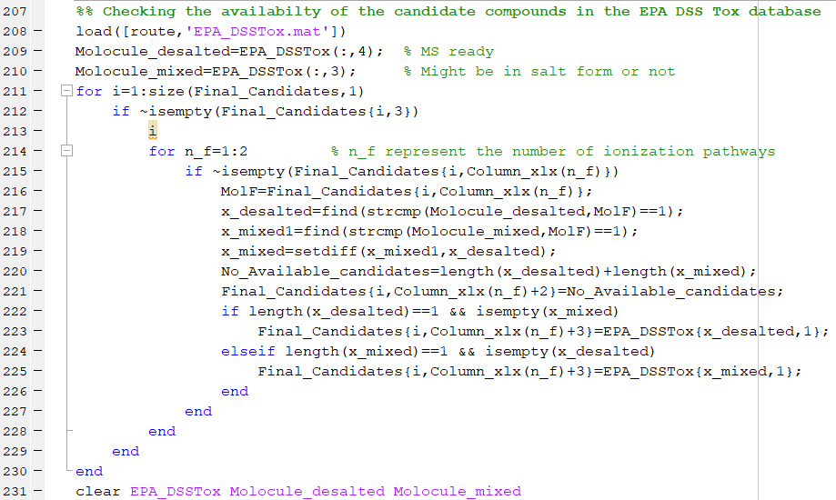
Notes:
“EPA_DSSTox.mat” is too big. I will share it on G-drive with you. See the structure of this file in the next slide. The address of this file should be updated and used as a central library for all sample processes.
“Known_Compounds_Search” is a big library of known compounds that were detected in APGC data so far through these years. You may update or modify this document to your application.

Slide 28
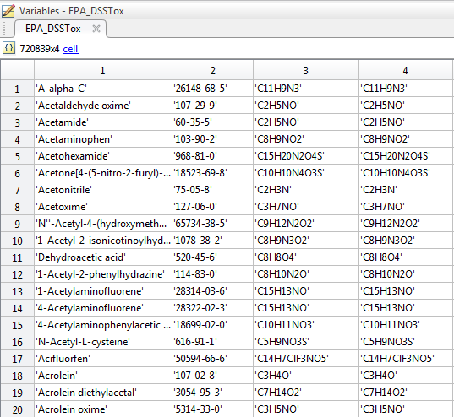
Notes:
Column 1 contains “name” of compound.
Column 2 contains CAS No. of compound.
Column 3 contains the salted form of molecular formula of compound.
Column 4 contains the desalted form of molecular formula which is called “MS ready” in comptox terminology.
The address of this file is set at line 5.

Slide 29
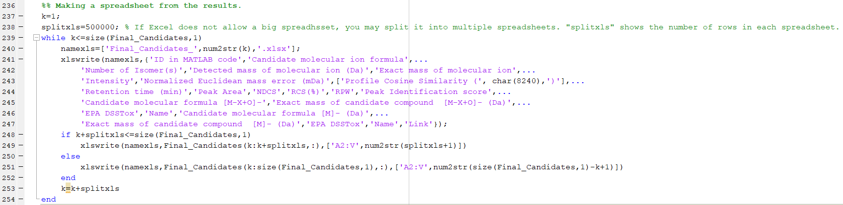
Channelizing the Output of OutputNeg.m

Slide 30
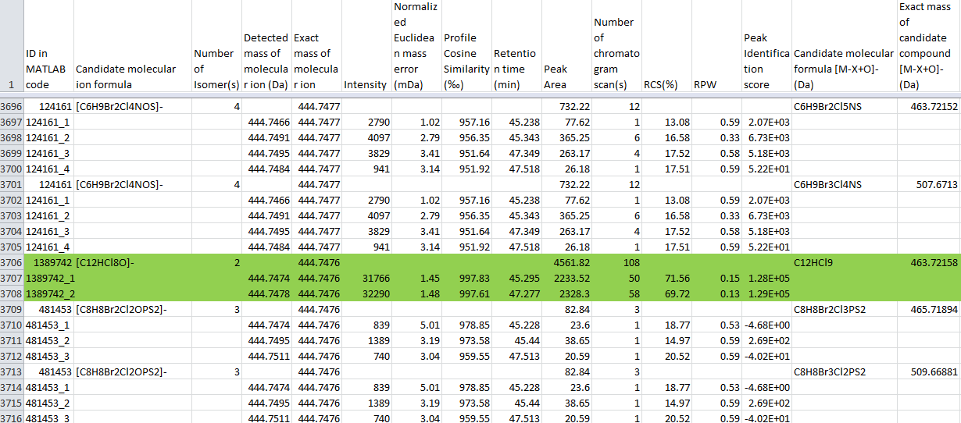
Spreadsheet

Slide 31
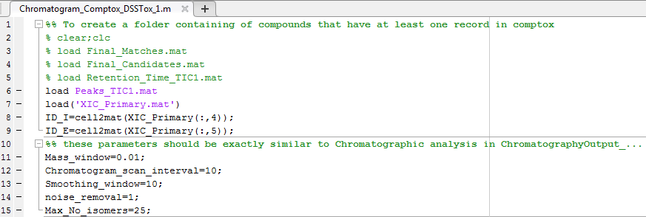
Chromatogram_EPA_DSSTox.m*
Notes:
Executing this file is optional and creates a folder of chromatograms of the compounds that have at least one record in EPA chemistry dashboard.
Runtime> 1 hour

Slide 32
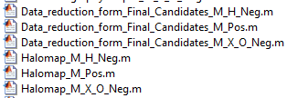
Data reduction
The following modules were developed to reduce data and generates halomaps. These modules were commented within the code.
These module could vary for each given data reduction scenario.

Slide 33
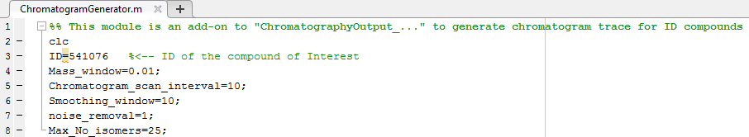
To generate chromatogram trace for ID compounds

Slide 34
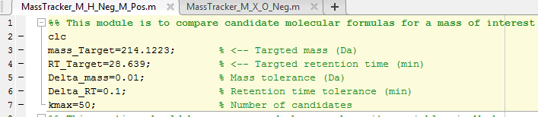
To find candidate molecular formulas for a feature

